Slide 1

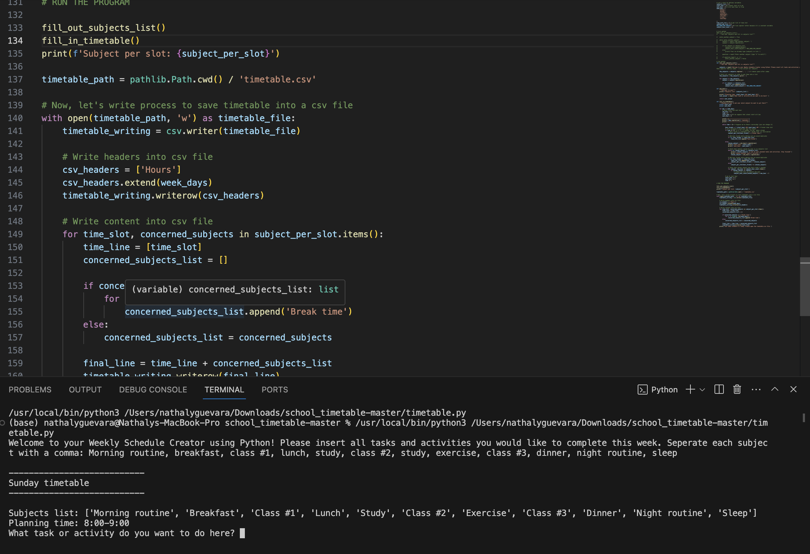
Weekly Schedule Creator
www.github.com/ksu-is/weekly-schedule-creator
A simple, yet smarter way to code and organize your week!
Presented by Nathaly Guevara

